Slide 1

Recommender System Basics
Presented By:
Dibyam Kumar Agrawal
Research Guide:
Bidyut Kumar Patra
Special Thanks to
IDAL Team

Slide 2
Why?
Enhance user experience
Helps to understand the customers better
Increase sale
Saves time

Slide 3
Recommender System
Raw
Data
Processed
Data
Model
Results
Input data
Training
Evaluation
Rating matrix
Item details
User demographic info
Content Based Filtering
Collaborative Filtering
Demographic Filtering
Hybrid Filtering
WRITE TYPES

Slide 4
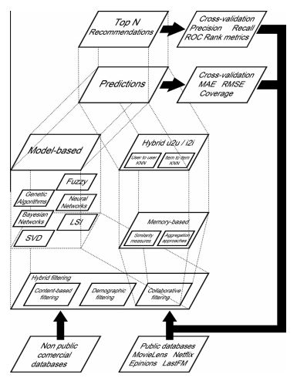

Slide 5
Content Based Filtering
Details
Item details are used to find similarity between items.
DRAWBACKS
Over Specification

Slide 6
Collaborative Filtering (CF)
Model Based CF
SVD
Bayesian
NN
Fuzzy system
Genetic Algorithm
Latent Feature
Matrix Factorization
Rating Matrix
Select Top N
Memory Based CF
Similarity Metric
Aggregation Method
KNN

Slide 7
Memory Based CF
User Based
Details
Item Based
Details

Slide 8
Memory Based CF - Similarity Metric
Details

Slide 9
Memory Based CF – Aggregation Method
Details

Slide 10
Model Based CF
Model Based CF
SVD
Bayesian
NN
Fuzzy system
Genetic Algorithm
Latent Feature
Matrix Factorization

Slide 11
Model Based CF - SVD
Details

Slide 12
Model Based CF – Matrix Factorization
Details

Slide 13
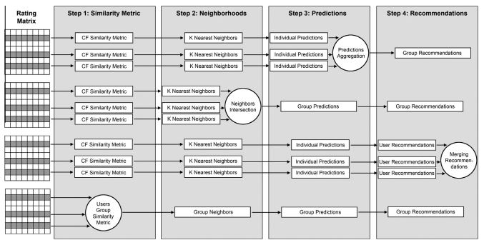
Group Recommendation

Slide 14
Collaborative Filtering
Drawbacks
Cold Start Problem

Slide 15
Demographic Filtering
Details

Slide 16
Hybrid Filtering
Details

Slide 17
Evaluation
Desired Properties
Accuracy
Novelty
Diversity
Stability
Reliability
Prediction Evaluation
Metric - MAE, RMSE, Coverage
Evaluation of set of recommended items
Metric – Precision, Recall, F1
Evaluation of ranked recommended items
Metric – Half life, discounted cumulative gain

Slide 18
Evaluation formulas
ADD PICS

Slide 19
Streaming RS
Details

Slide 20
Topics to cover
TO DO-
Group by
Group
Graph
Implicit Feedback
Data Sparsity
Cold Start Problem
Scalability
Normalization
Bias

Slide 21
Future & Challenges
Details

Slide 22
Thank You

